Slide 1
DRAW A HOUSE
Created by Dr. Kris Acheson-Clair, CILMAR, based on the following:
Hall, E.T. (1966). The hidden dimension. Anchor Books.

Slide 2
DRAW A HOUSE
Instructions
With your paper and writing utensil, you have five minutes to draw a floor plan of a house.
Your floor plans should be as detailed as possible and include the following:
Entrances
Furniture
Labels on rooms with particular functions and a brief explanation of what people do in them.
After the five minutes is over, pair up or talk in small groups to compare and contrast your drawings

Slide 3
FLOOR PLAN FROM JAPAN
Average home sizes:
Hong Kong – 484 ft²
Japan – 1023 ft²
Spain – 1044 ft²
US – 2164 ft²
Australia – 2303 ft²
http://shrinkthatfootprint.com/how-big-is-a-house
Image retrieved from https://i.ytimg.com/vi/rzclivF9Jes/maxresdefault.jpg

Slide 4
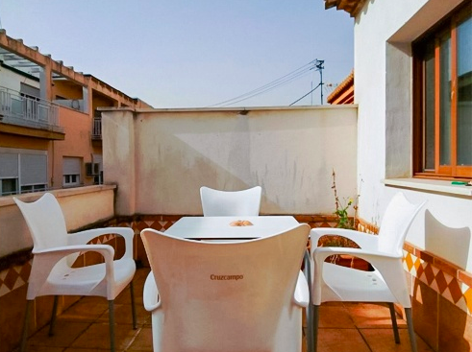
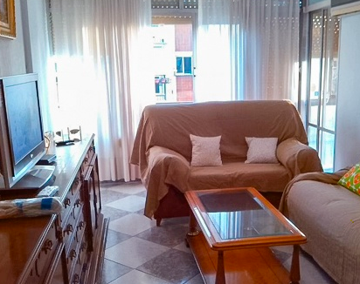
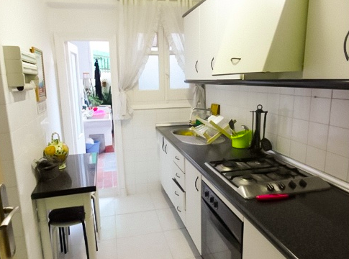
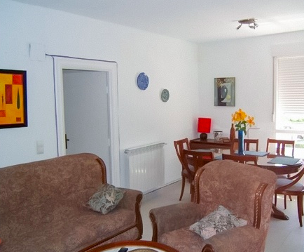
APARTMENT IN SPAIN
Most people in Spain live in multi-generational homes – grandparents, parents, and adult unmarried children, for example.
Stucco, tile, narrow alleys, shaded courtyards, and patios are common.
Images retrieved from https://www.pisocompartido.com/

Slide 5
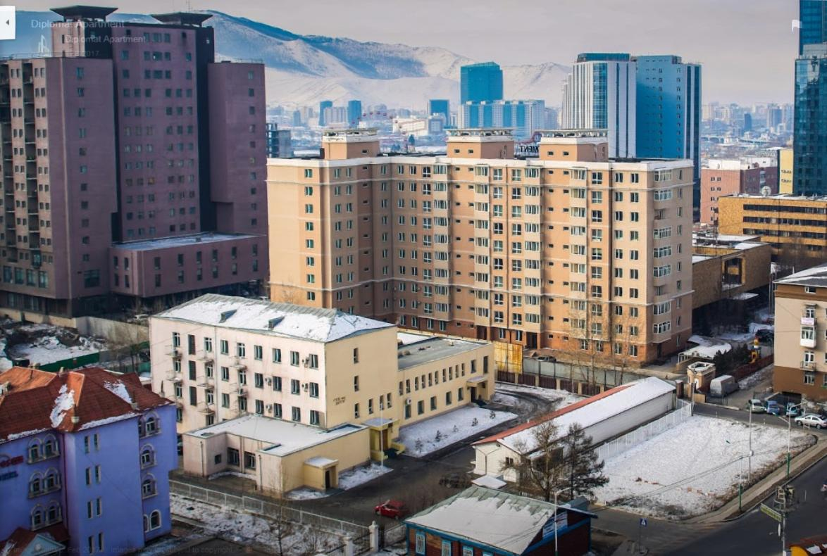
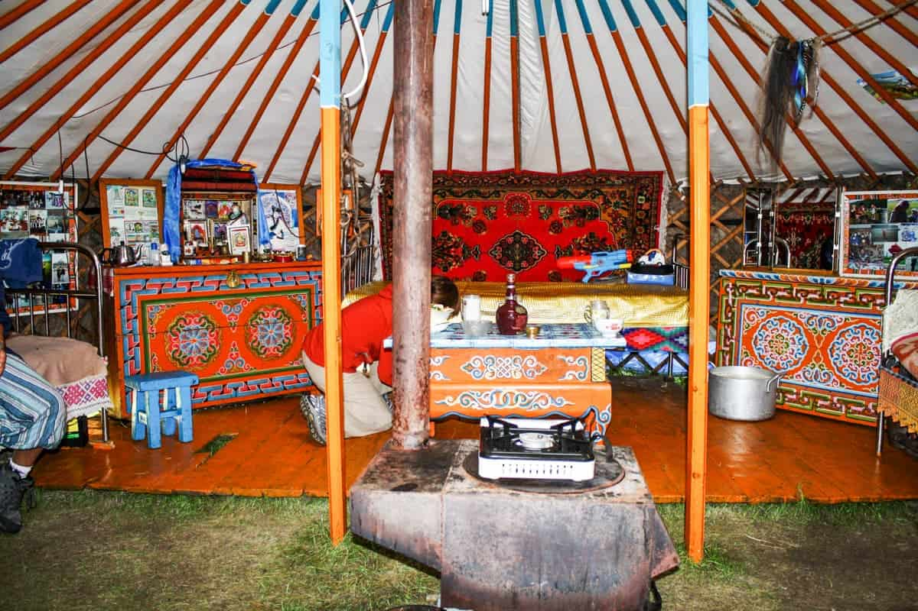
HOUSES IN MONGOLIA
Roughly half of Mongolia’s population lives in flats in the capital city of Ulaanbaatar.
Many of the rest live on the steppes in traditional nomadic (mobile) gers or yurts.
Photos from www.booking.com, http://discovermongolia.mn, and www.bordersofadventure.com
Images retrieved from ___, http://discovermongolia.mn, and https://www.bordersofadventure.com/

Slide 6
DEBRIEF (PART 1)
What are the similarities that you saw between your drawings? What about with the images on the previous slide?
Did you notice any differences between your drawings? What about with the images on the previous slide?

Slide 7
DEBRIEF (PART 2)
What sorts of conclusions can we draw about behaviors/norms/values in our culture that influence how we shape the space/environments around us?
What does that say about our values as a society?
Do we value aesthetic appearance or the functionality?
What about the impact of availability of space—what influences do you see of population density in the drawings?
How do changing values and practices in society affect the styles of houses over time?
What is it like to enter a person’s home that is arranged differently to what we’re used to?
How do you adapt and figure out what is expected of you?
What should you be looking for?
How can you politely ask questions to figure out what is acceptable in that space?

